Slide 1
Setting for this evening…
You are a Product Manager at Songify, one of the largest providers of streaming music. You are responsible for personal playlists, assembled for each user using machine learning. This has been a surprisingly popular product.
Now one of your ML teams tells you that they've created a new ML-based personalized playlist generator that's better than the existing one.
What do you do now?
Can you come up with a step-by-step plan?
Or at least a set of things that you should do/consider?

Slide 2
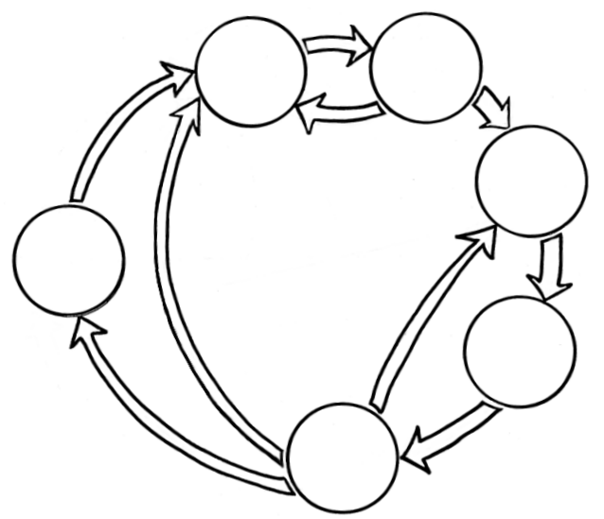
Business Understanding
Data Understanding
Data Preparation
Data Science
Process
Deployment
Modeling
Evaluation

Slide 3
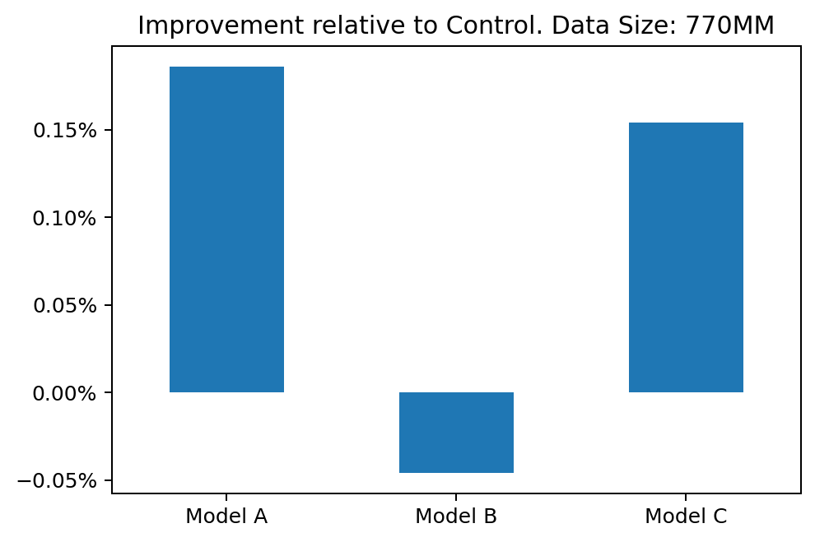
A/B/C/D Test at Spotify
These are three new playlist generation algorithms vs. the incumbent at Spotify
The goal here is increased listening time.
Real!
Notes:
Few people do causal targeting
More do A/B testing and other RCTs for evaluating causal impact
It’s important to get the difference between those two very clear in our minds, as well as the challenges of A/B testing when it comes to ML applications

Slide 4
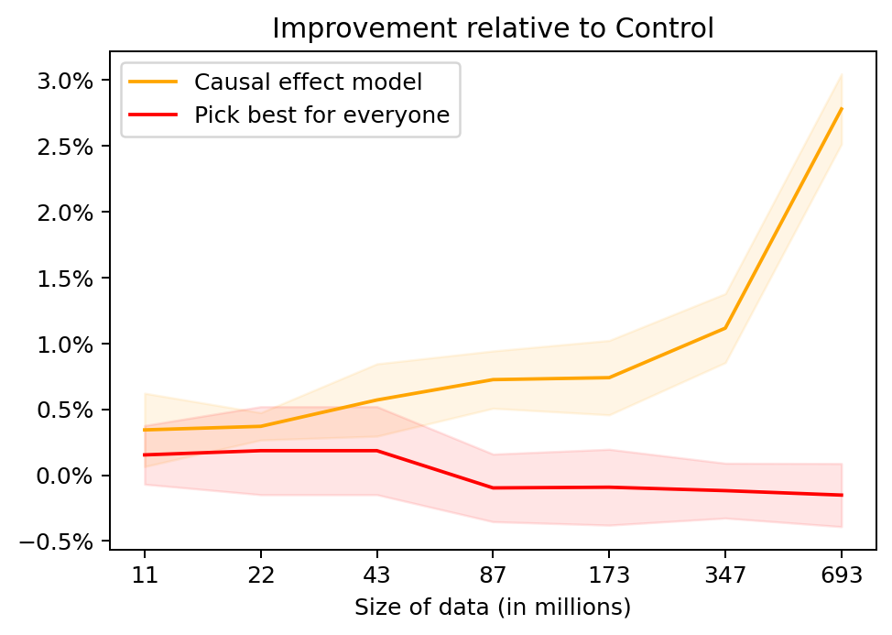
Let’s do even better still…
Choice here:
Pick the best playlist generation algorithm for everyone vs. for each individual user.
Here we are learning a causal effect prediction model, and then targeting each individual with the treatment (one of the four playlist gen. algs.) that gives the largest effect
Notes:
- Not much of an advance over A/B testing, but at least we can say we are predicting which alg will be best and then evaluating. Not such a big deal for a large A/B test, but bear with me here.

